Slide 1



Telecom Customer Retention Dashboard
View in Power BI
Last data refresh:
11/10/2021 5:25:15 AM UTC
Downloaded at:
11/10/2021 5:27:11 AM UTC

Slide 2
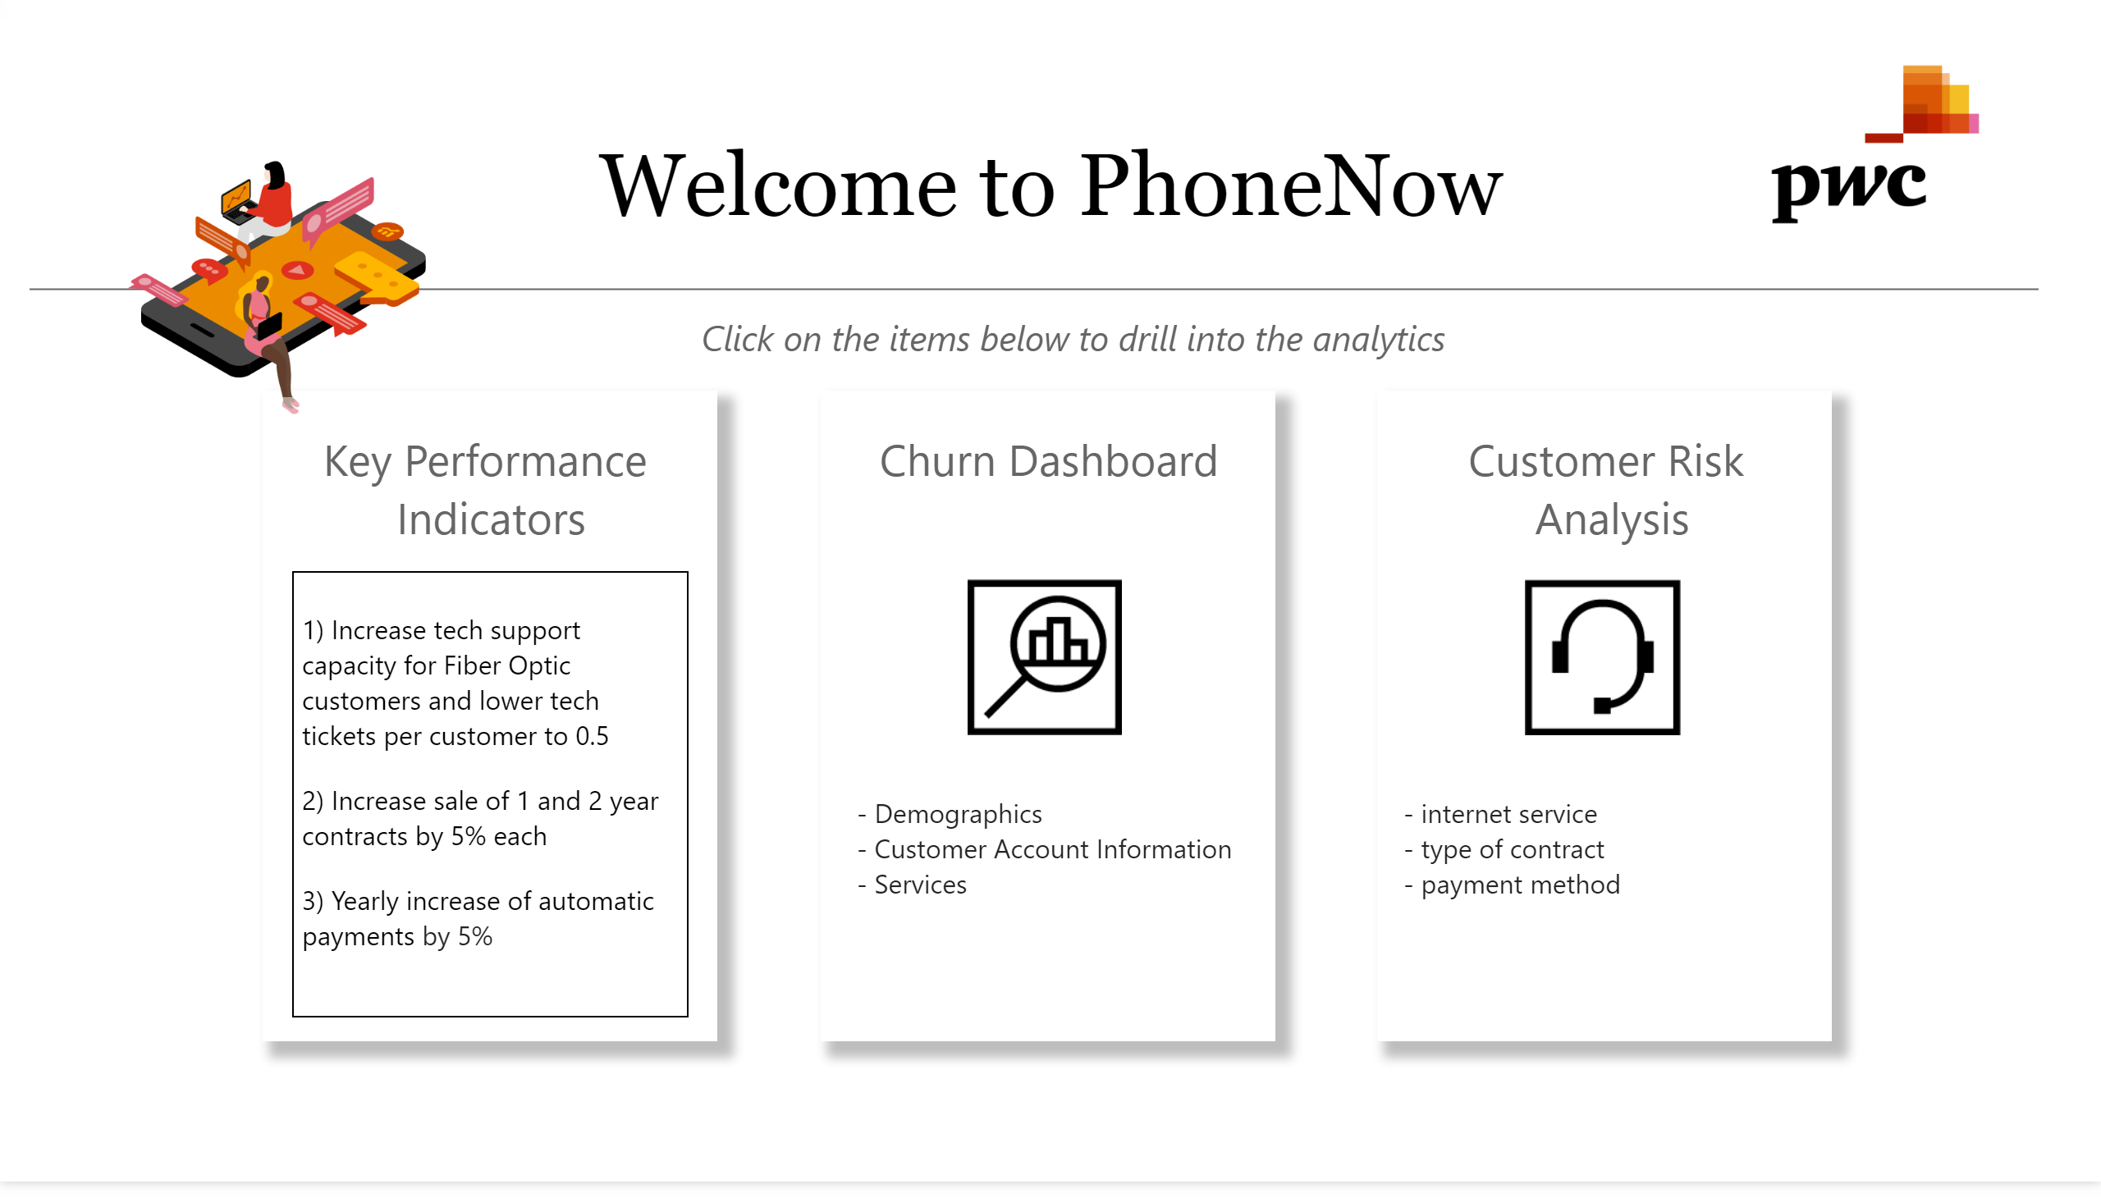
PhoneNow Customer Risk Analysis Dashboard
Notes:
textbox
No alt text provided.
basicShape
No alt text provided.
image
No alt text provided.
textbox
No alt text provided.
image
No alt text provided.
textbox
No alt text provided.
image
No alt text provided.
textbox
No alt text provided.
basicShape
No alt text provided.
basicShape
No alt text provided.
textbox
No alt text provided.
textbox
No alt text provided.
basicShape
No alt text provided.
textbox
No alt text provided.
textbox
No alt text provided.
image
No alt text provided.

Slide 3
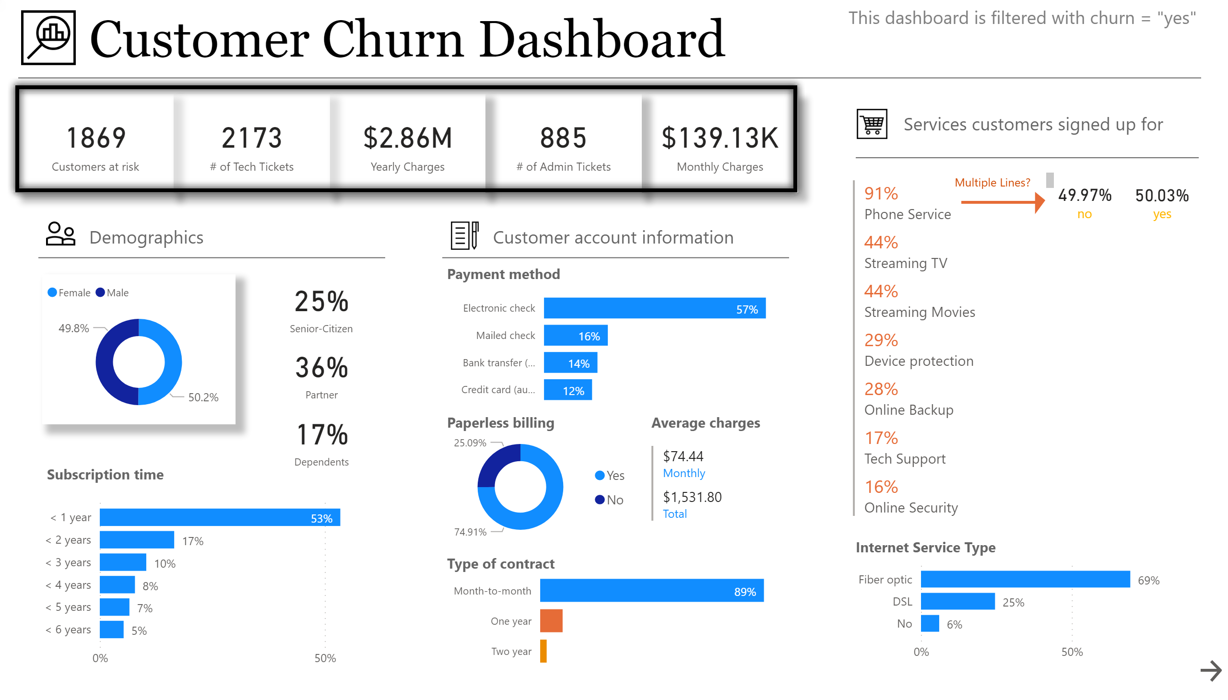
Churn Dashboard
Notes:
textbox
No alt text provided.
basicShape
No alt text provided.
basicShape
No alt text provided.
card
No alt text provided.
card
No alt text provided.
card
No alt text provided.
card
No alt text provided.
card
No alt text provided.
basicShape
No alt text provided.
basicShape
No alt text provided.
textbox
No alt text provided.
basicShape
No alt text provided.
image
No alt text provided.
textbox
No alt text provided.
basicShape
No alt text provided.
image
No alt text provided.
textbox
No alt text provided.
basicShape
No alt text provided.
image
No alt text provided.
donutChart
No alt text provided.
card
No alt text provided.
card
No alt text provided.
card
No alt text provided.
clusteredBarChart
No alt text provided.
clusteredBarChart
No alt text provided.
textbox
No alt text provided.
textbox
No alt text provided.
donutChart
No alt text provided.
multiRowCard
No alt text provided.
textbox
No alt text provided.
barChart
No alt text provided.
card
No alt text provided.
card
No alt text provided.
textbox
No alt text provided.
textbox
No alt text provided.
textbox
No alt text provided.
multiRowCard
No alt text provided.
basicShape
No alt text provided.
basicShape
No alt text provided.
textbox
No alt text provided.
clusteredBarChart
No alt text provided.
textbox
No alt text provided.
actionButton
No alt text provided.
image
No alt text provided.
textbox
No alt text provided.
shape
No alt text provided.
textbox
No alt text provided.

Slide 4
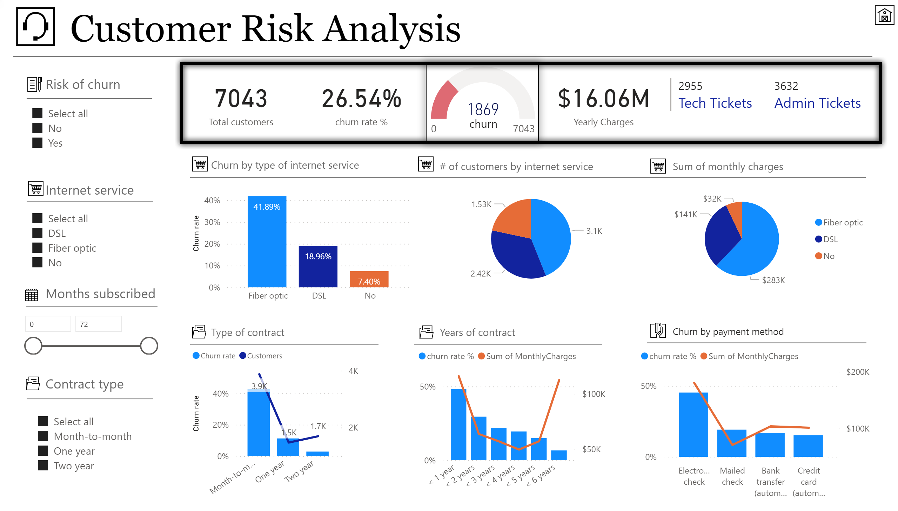
Customer Risk Analysis
Notes:
textbox
No alt text provided.
basicShape
No alt text provided.
basicShape
No alt text provided.
basicShape
No alt text provided.
card
No alt text provided.
gauge
No alt text provided.
slicer
No alt text provided.
card
No alt text provided.
slicer
No alt text provided.
Number of months subscribed
No alt text provided.
basicShape
No alt text provided.
image
No alt text provided.
image
No alt text provided.
textbox
No alt text provided.
basicShape
No alt text provided.
textbox
No alt text provided.
basicShape
No alt text provided.
textbox
No alt text provided.
image
No alt text provided.
image
No alt text provided.
textbox
No alt text provided.
basicShape
No alt text provided.
slicer
No alt text provided.
image
No alt text provided.
card
No alt text provided.
lineClusteredColumnComboChart
No alt text provided.
lineClusteredColumnComboChart
No alt text provided.
textbox
No alt text provided.
basicShape
No alt text provided.
clusteredColumnChart
No alt text provided.
pieChart
No alt text provided.
pieChart
No alt text provided.
textbox
No alt text provided.
textbox
No alt text provided.
basicShape
No alt text provided.
basicShape
No alt text provided.
textbox
No alt text provided.
textbox
No alt text provided.
basicShape
No alt text provided.
basicShape
No alt text provided.
lineClusteredColumnComboChart
No alt text provided.
basicShape
No alt text provided.
textbox
No alt text provided.
multiRowCard
No alt text provided.
basicShape
No alt text provided.
image
No alt text provided.
image
No alt text provided.
image
No alt text provided.
image
No alt text provided.
image
No alt text provided.
image
No alt text provided.
textbox
No alt text provided.
image
No alt text provided.
shape
No alt text provided.

Slide 5
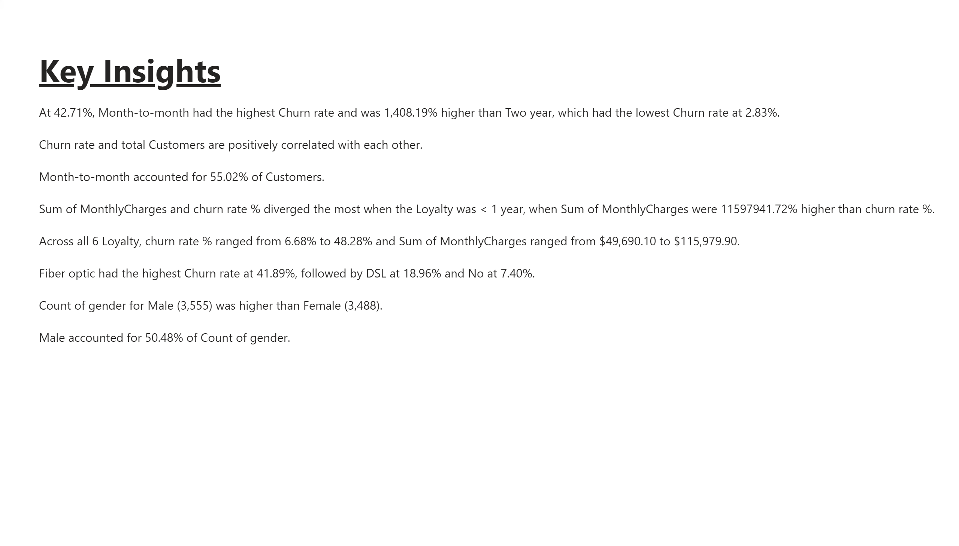
Report Narrative
Notes:
textbox
No alt text provided.

